Slide 1

The Group of Fusion Force:
Maryum Sami
Abid
Maria Fazal
Sohail Ahmed
Irsa Riaz

Slide 2
NUCLEAR FUSION
Nuclear Fusion:
"In the 1920s, Arthur Eddington suggested that the Sun’s energy comes from hydrogen fusion.”
It is a process in which two light nuclei combine to form a heavier nucleus, releasing a large
amount of energy.
Example:
Hydrogen nuclei fuse to form helium
In the sun.

Slide 3
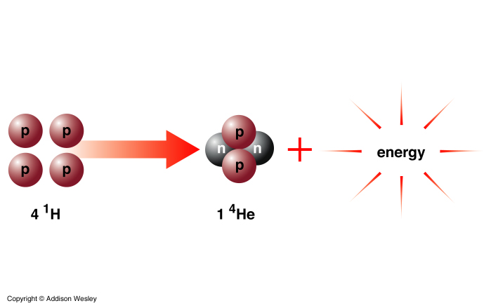
Nuclear Fusion

Slide 4
Controlled vs Uncontrolled Nuclear Fusion
Control of Reaction:
Controlled Fusion: Reaction is carefully controlled.
Uncontrolled Fusion: Reaction is not controlled; it happens suddenly.
2. Energy Release:
Controlled Fusion: Energy is released gradually and safely.
Uncontrolled Fusion: Energy is released instantly and massively.
3. Use/Purpose:
Controlled Fusion: Used for peaceful purposes, like power plants.
Uncontrolled Fusion: Used for destructive purposes, like hydrogen bombs.

Slide 5
4. Safety:
Controlled Fusion: Safe for humans and environment.
Uncontrolled Fusion: Extremely dangerous, can cause explosions and destruction.
“Nuclear Fusion Processes”
1.Proton-Proton Chain (pp-chain):
Occurs in the Sun and small stars
Energy is released as light and heat.
2.CNO Cycle (Carbon-Nitrogen-Oxygen Cycle):
Occurs in massive stars
Produces more energy than the pp-chain

Slide 6
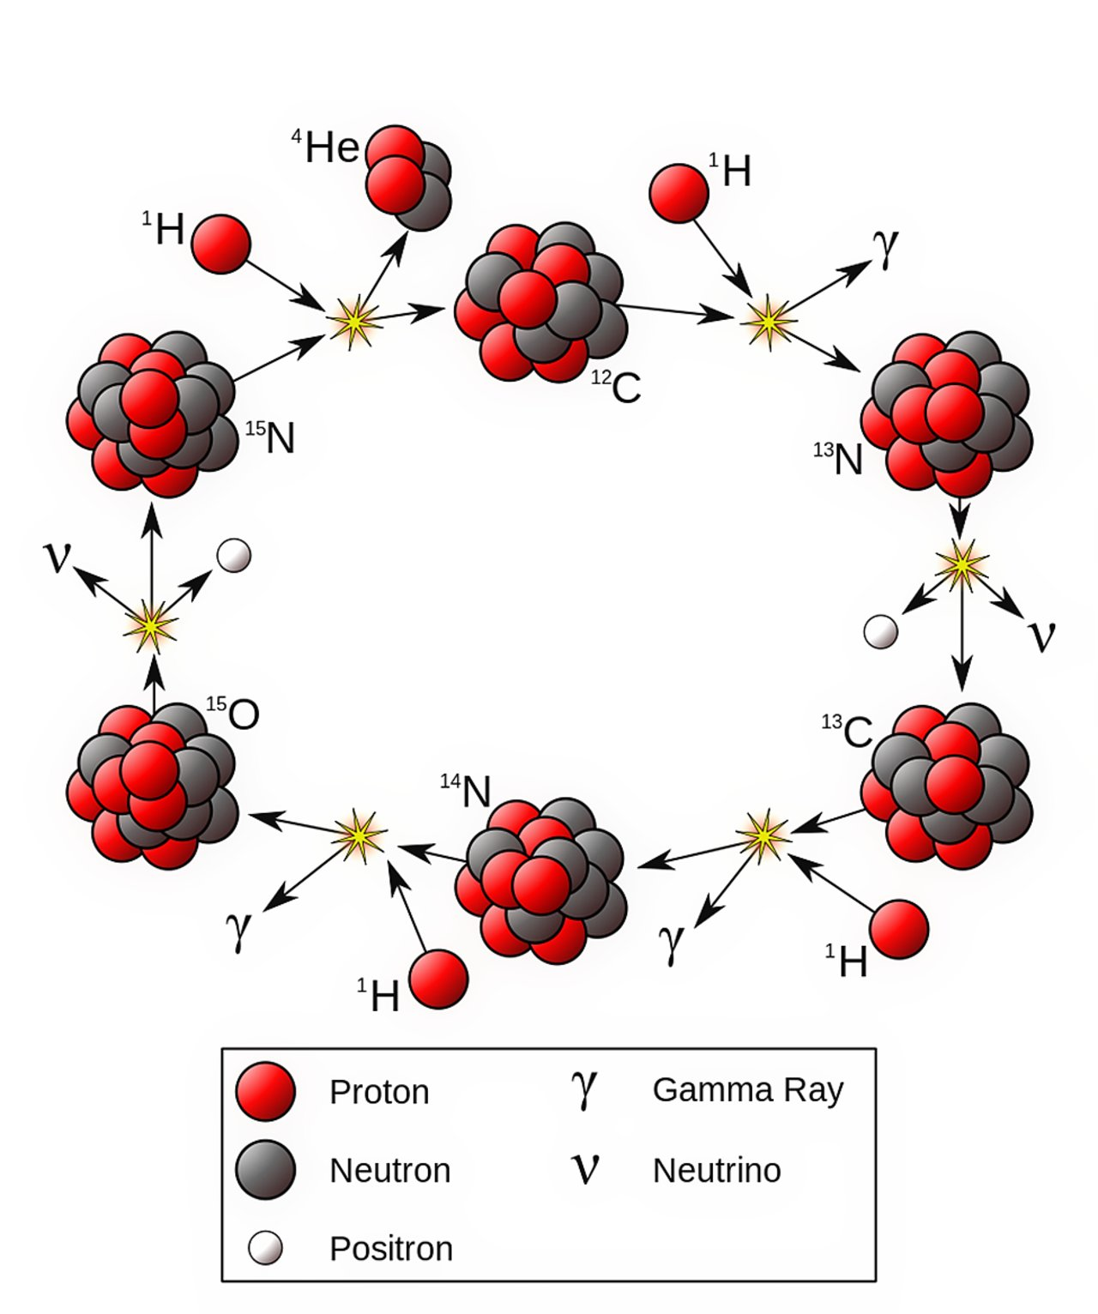
The carbon –Nitrogen – Oxygen(CNO) cycle

Slide 7
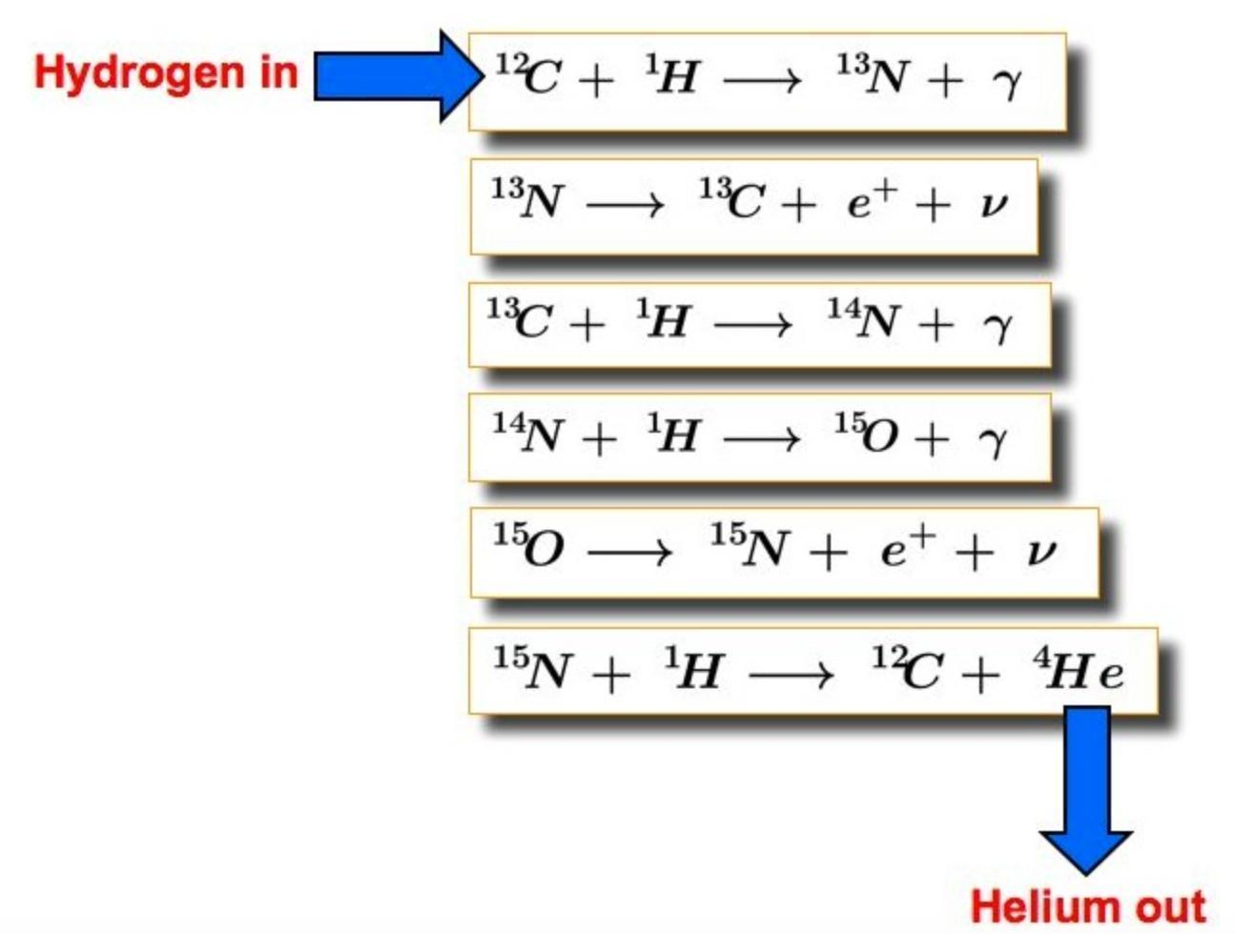

Slide 8
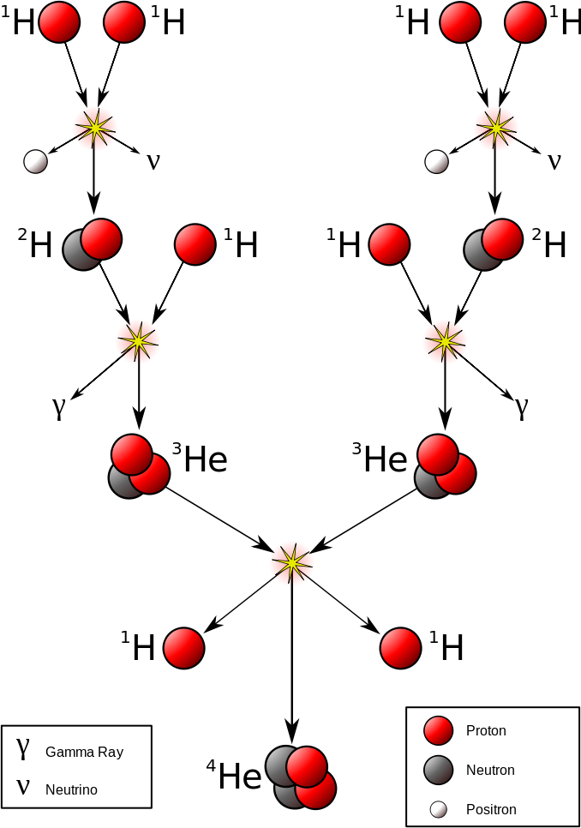
The Proton-Proton Cycle or Chain (pp-chain):

Slide 9
Nuclear Fusion Reaction
It is the scientific equation or example of the fusion process.
In other words, when we write the actual reaction that takes place during fusion,
it is called a Fusion Reaction

Slide 10

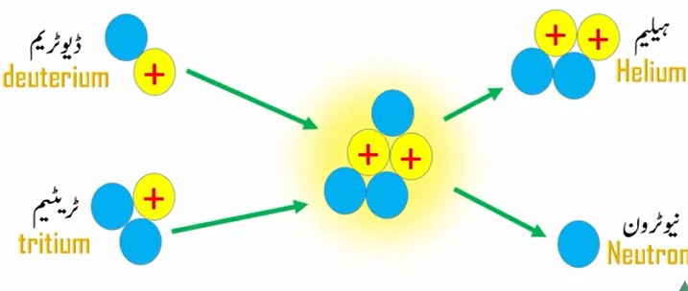
Reaction Name:
Deuterium–Tritium Fusion Reaction

Slide 11
Fission vs Fusion differences
1.Definition:
Fission → Heavy nucleus splits
Fusion → Light nuclei combine
2.Energy:
Fission → High, sudden
Fusion → Very high, gradual
3.Examples:
Fission → Nuclear reactor, atomic bomb
Fusion → Sun, stars, future reactors
4.Safety:
Fission → Risky
Fusion → Safer

Slide 12
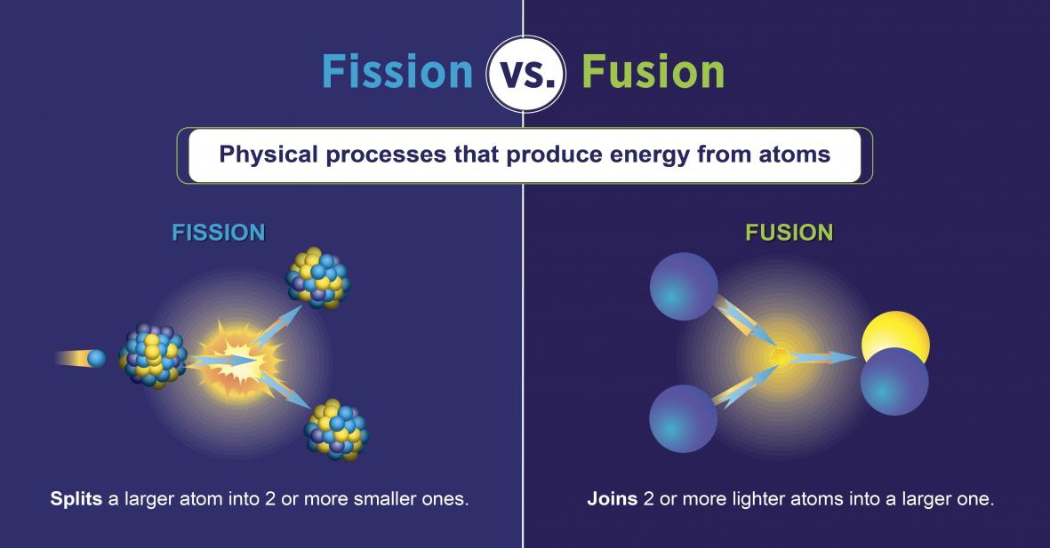
This Photo by Unknown Author is licensed under CC BY-SA-NC

Slide 13
Uses and Abuses of Nuclear Fusion
Do you know the uses & abuses of Nuclear Fusion?
💭
How does the Sun produce so much energy every second?
“Have you ever thought… 🤔”

Slide 14
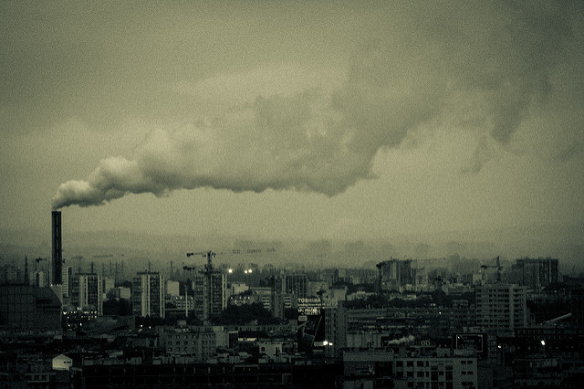
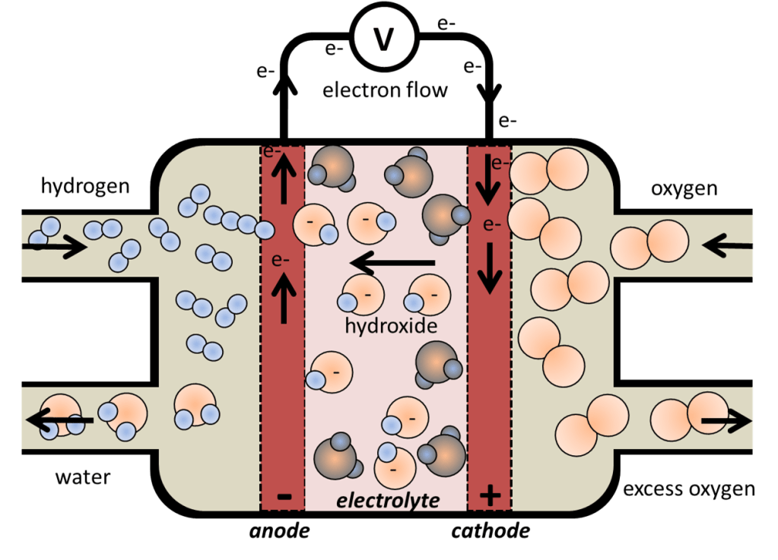
Uses of nuclear fusion
Produces clean and renewable energy.
No greenhouse gases or pollution.
Fuel (Hydrogen) is easily available from water.
No danger of chain reaction or meltdown.
Produces less radioactive waste.
Can power spacecraft and future power plants.

Slide 15
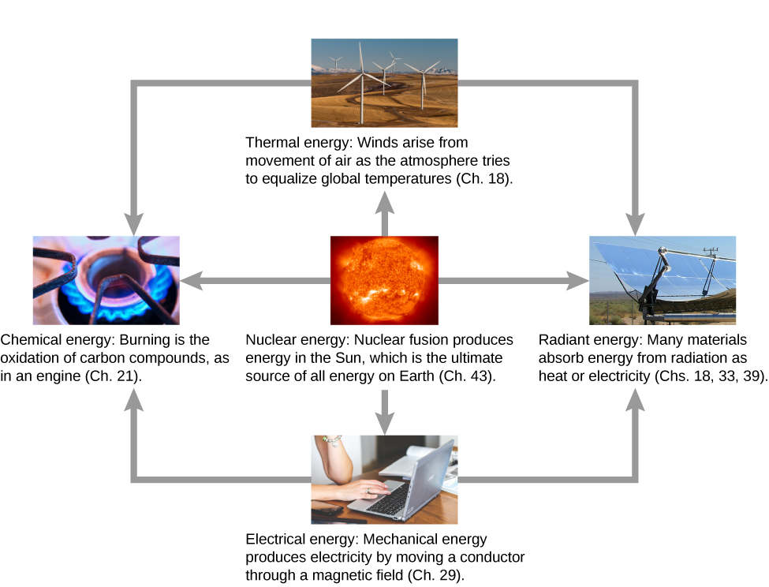
Advantages of Nuclear Fusion:

Slide 16
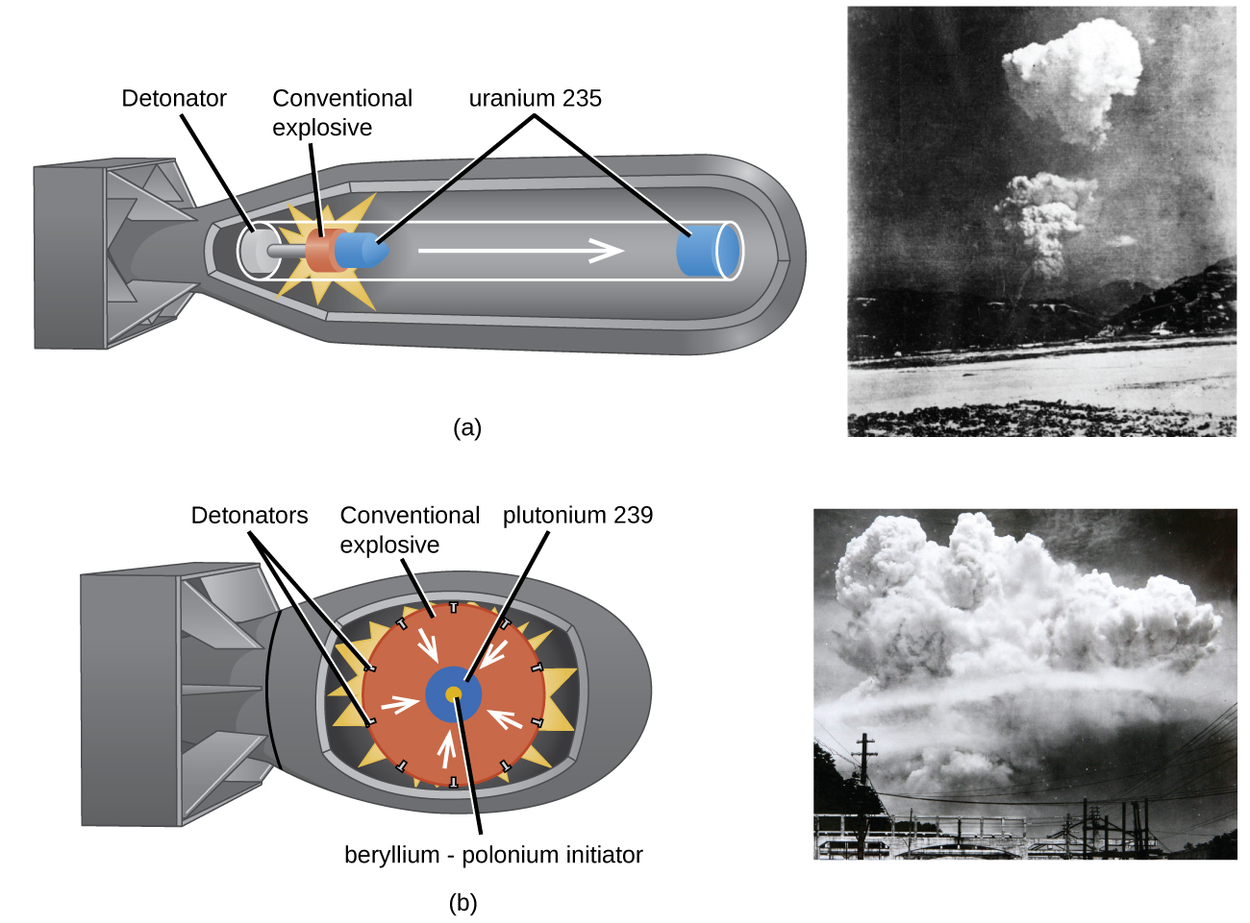
Abuses of nuclear fusion
Produces clean and Used in Hydrogen bombs (H-bombs) – extremely dangerous.
Very costly and hard to control process.
Can cause radiation hazards.
Misuse can lead to war and destruction.
May cause environmental harm if mishandled.
renewable energy.
No greenhouse gases or pollution.
Fuel (Hydrogen) is easily available from water.
No danger of chain reaction or meltdown.
Produces less radioactive waste.
Can power spacecraft and future power plants.

Slide 17

Once Again, I am repeating this topic:
“Nuclear Fusion and Fission are two ways to release nuclear energy. Fusion is the future of safe, clean energy, while Fission is currently used in power plants.”
😊
🎉

